Slide 1
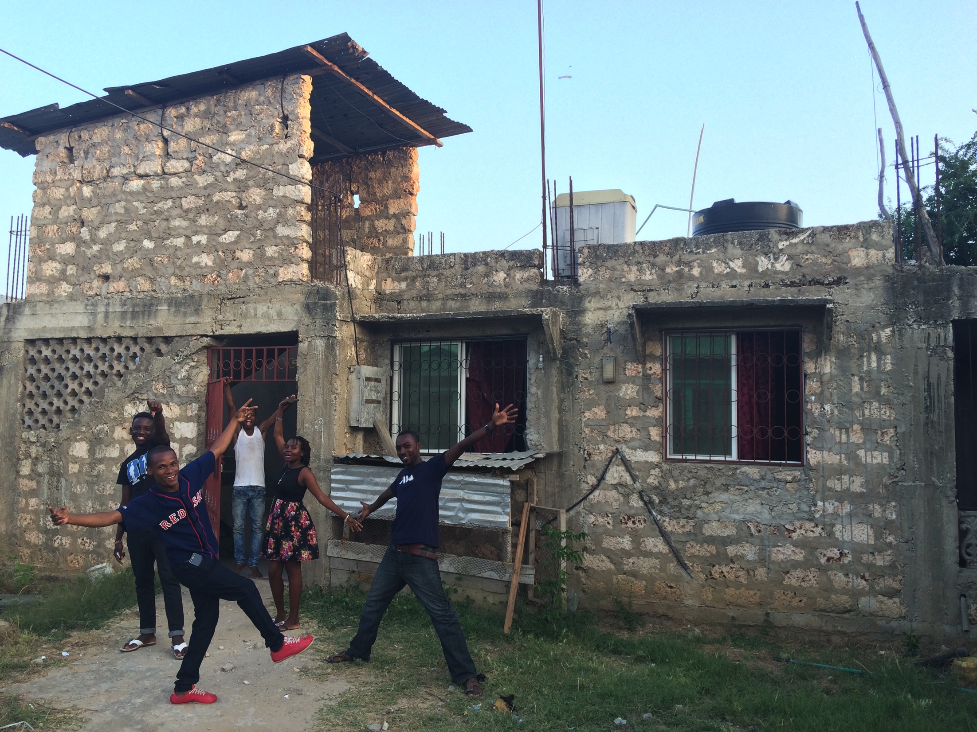
DREAM ACHIEVERS YOUTH ORGANISATION (DAYO) – MOMBASA, KENYA

Slide 2
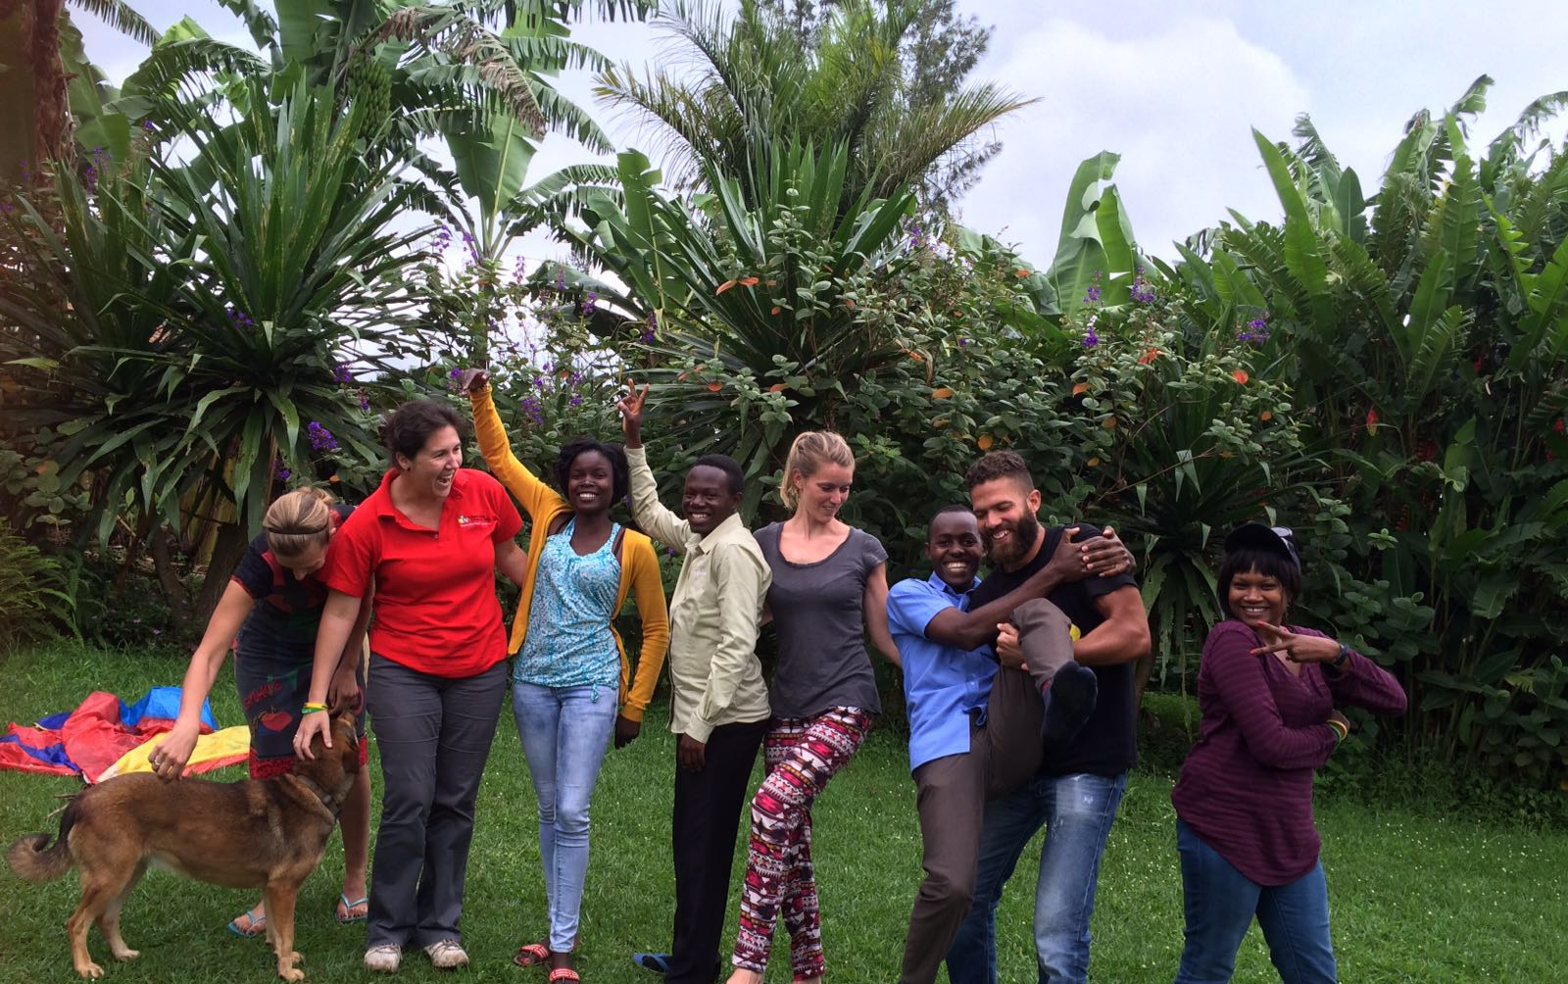
KYANINGA CHILD DEVELOPMENT CENTRE (KCDC) – FORT PORTAL, KAMPALA

Slide 3
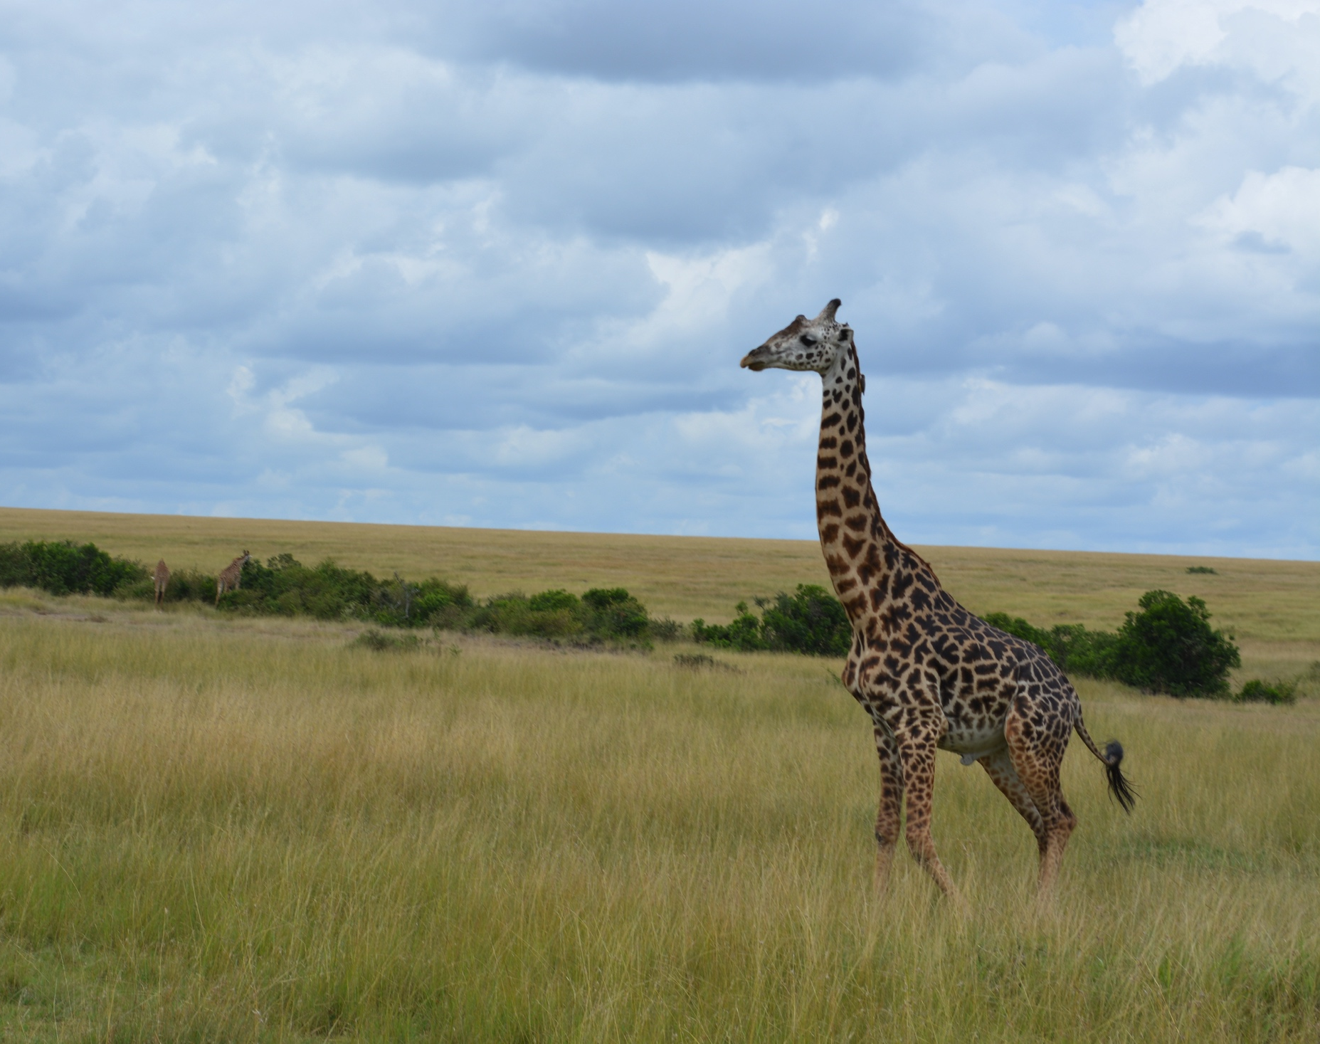
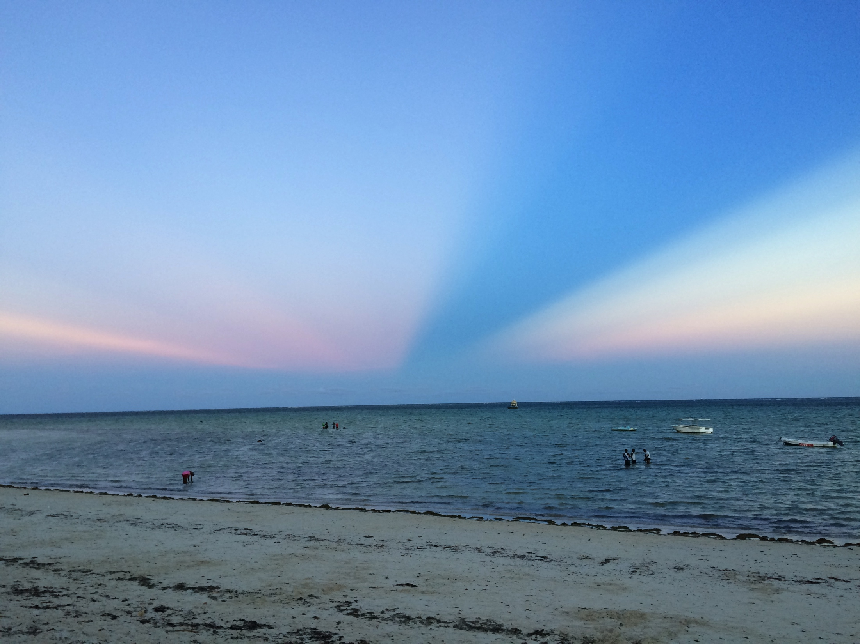
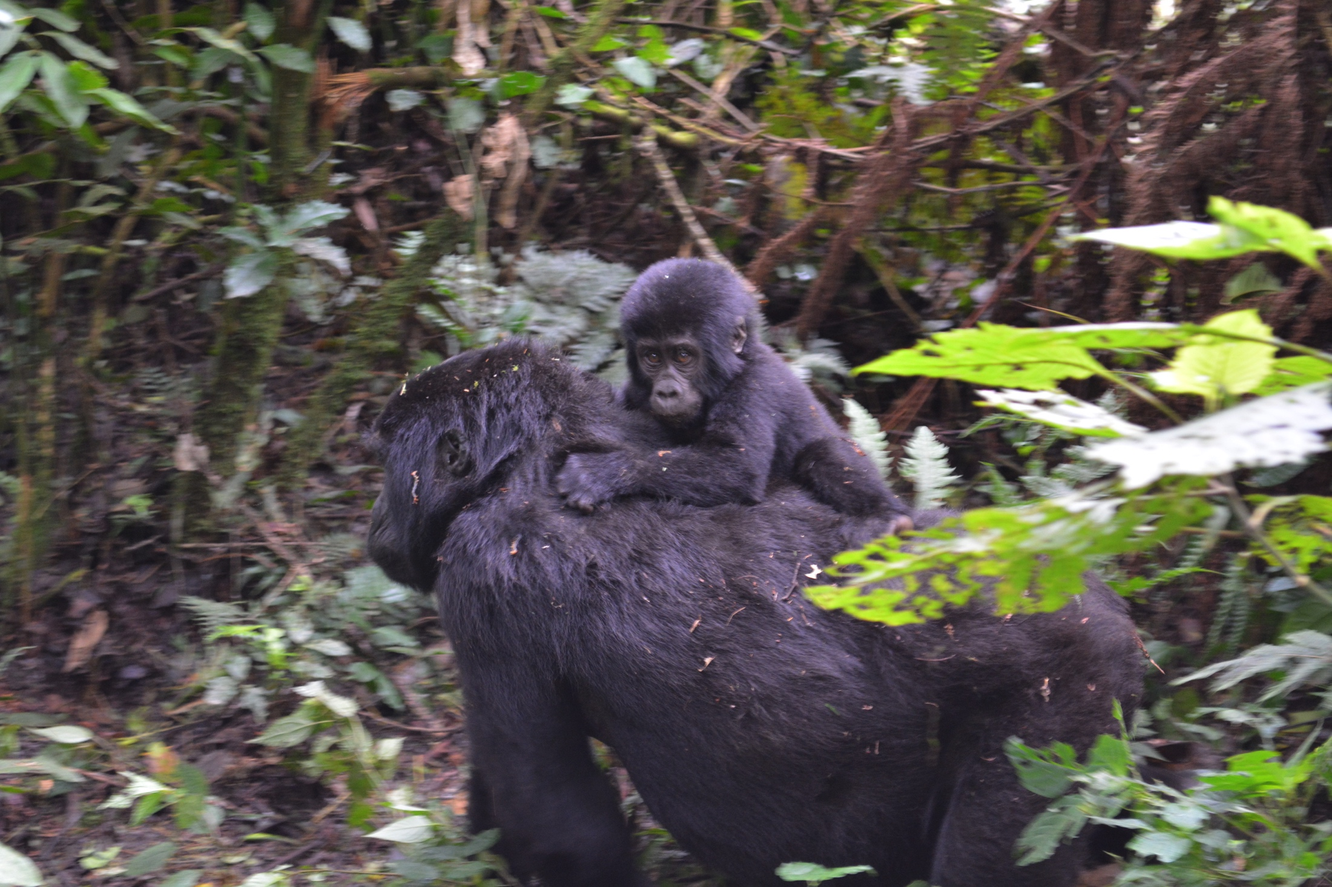
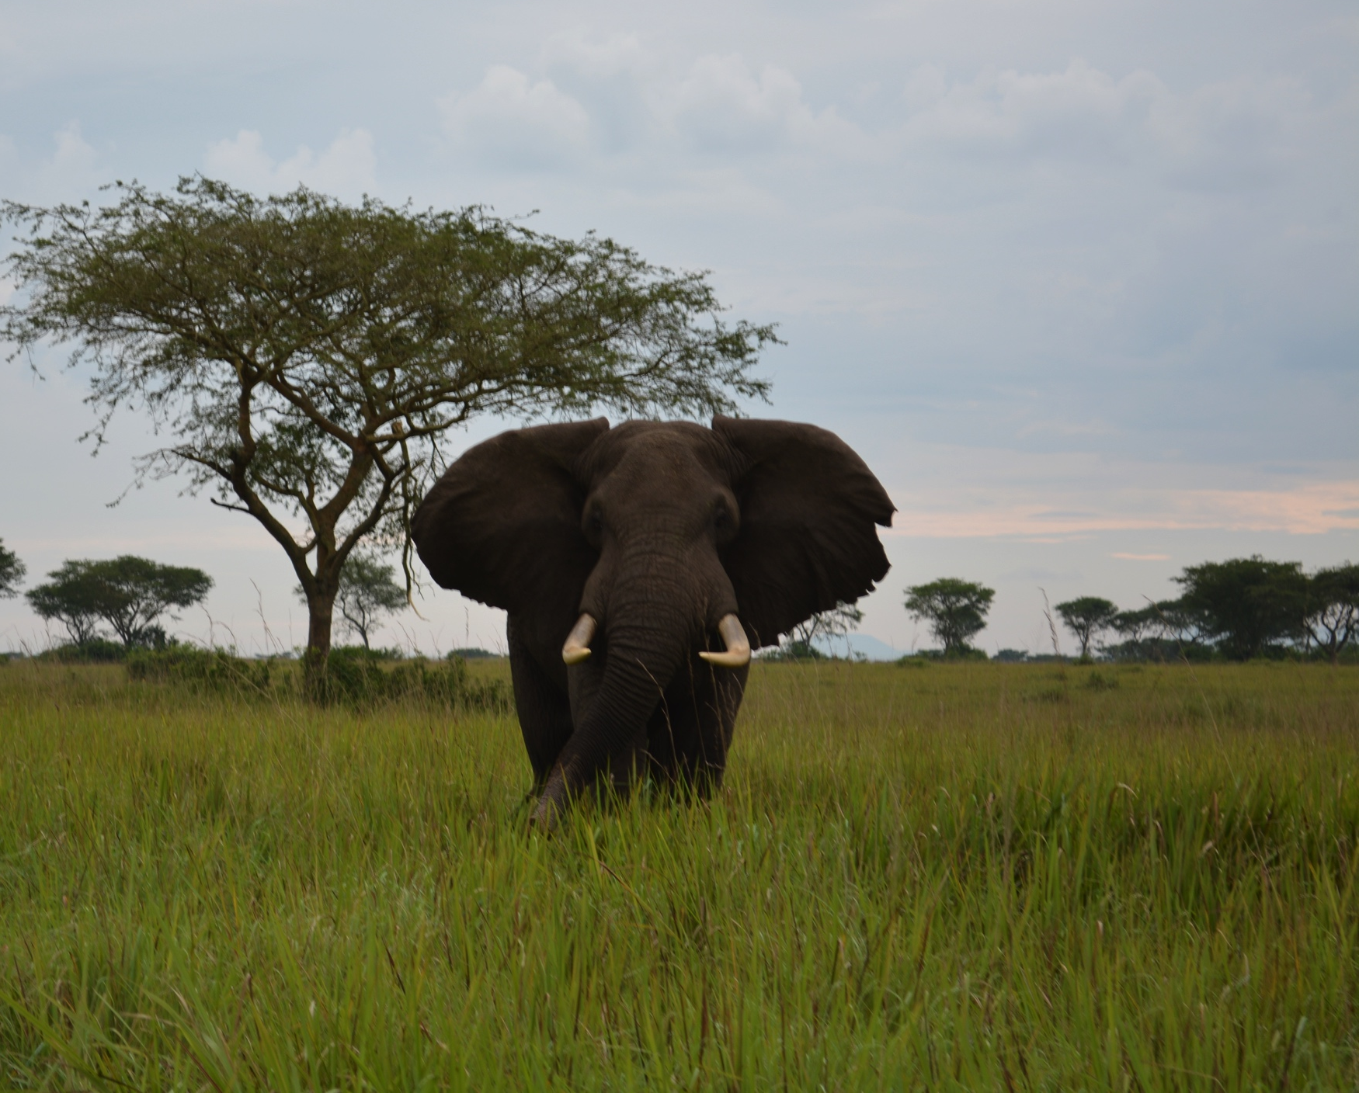
WHY?
David Attenborough
Work Satisfaction
Invaluable Experience
International Development ???

Slide 4
How did I ‘help’ ?
Excel
Excel
Excel
Objectives completed / Financial Assessment
Tasks completed outside of main objectives
Knowledge of specific accounting software

Slide 5
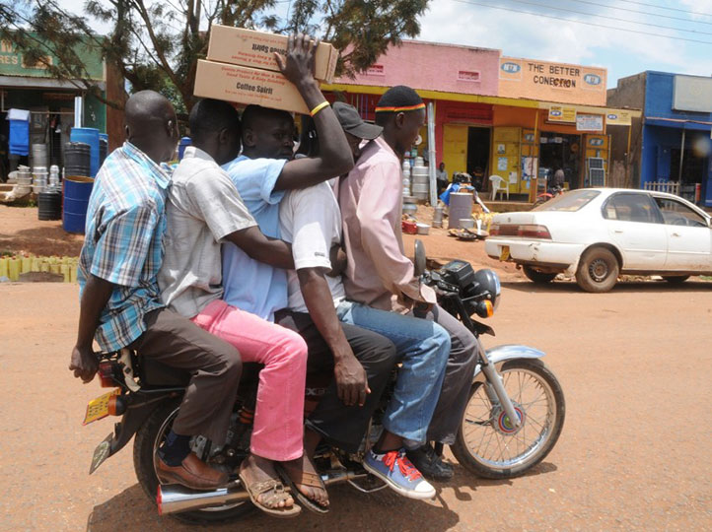
Day at work
The commute…

Slide 6
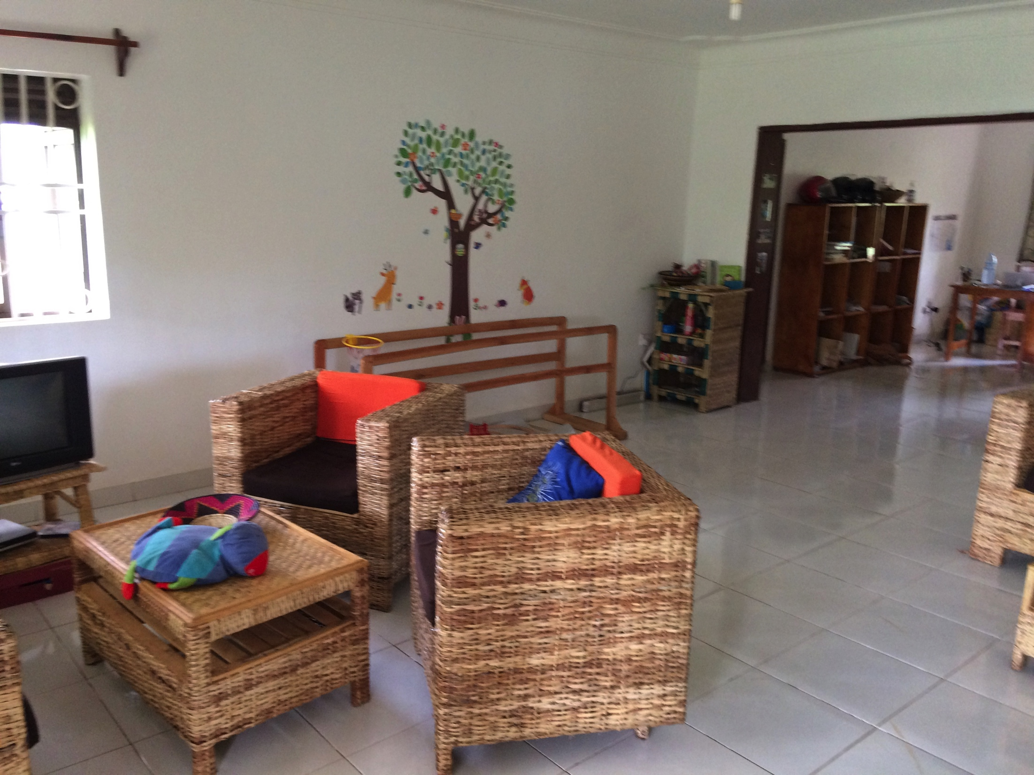
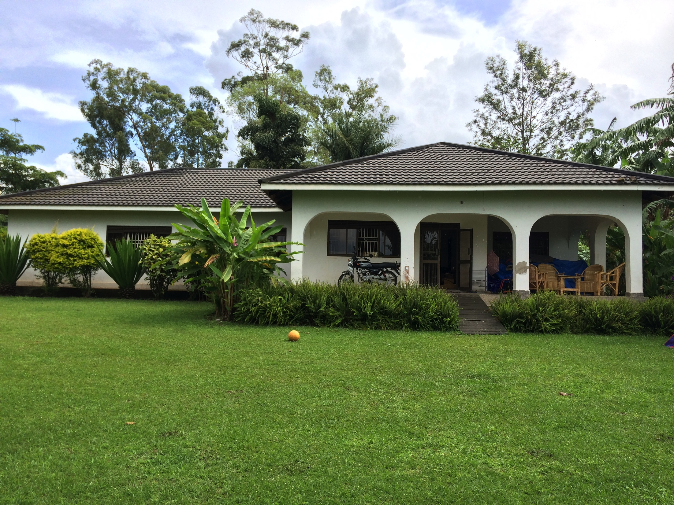
The Office….

Slide 7
The other office….

Slide 8
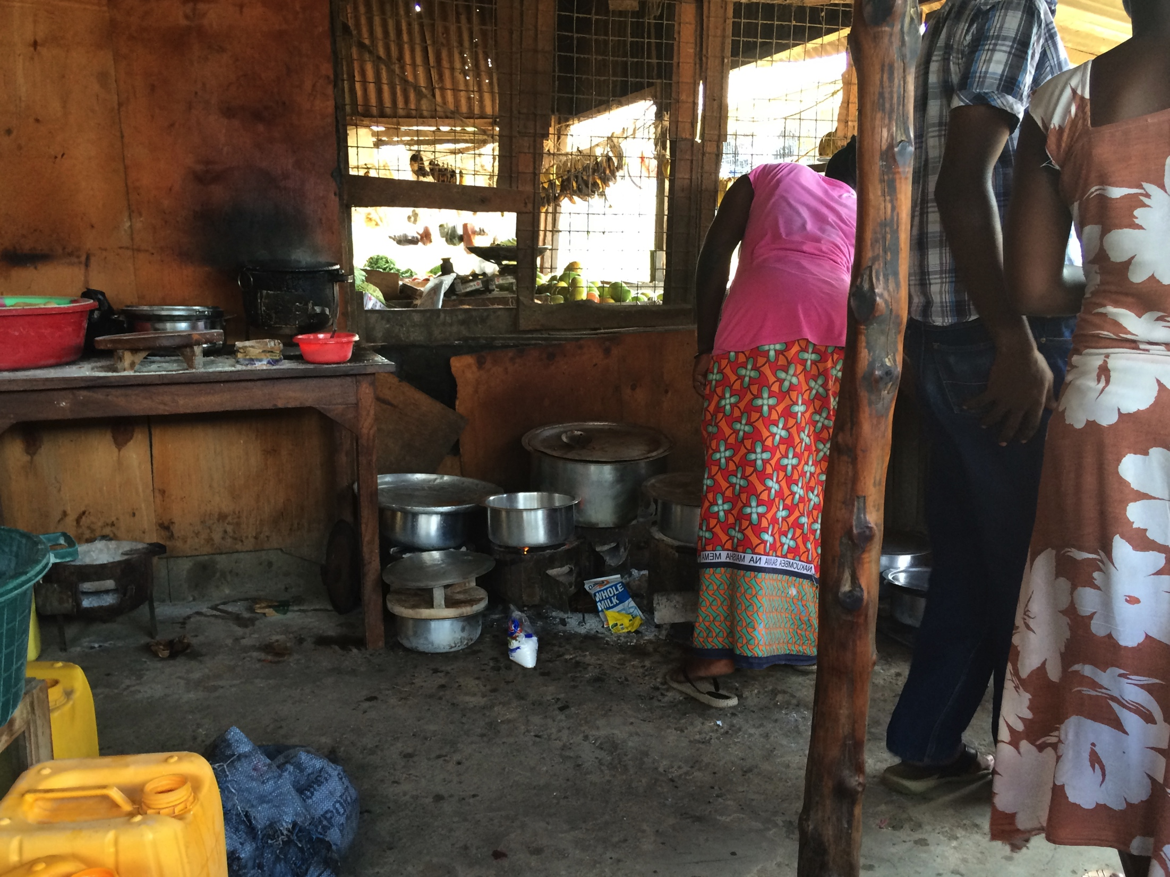
Lunch…..

Slide 9
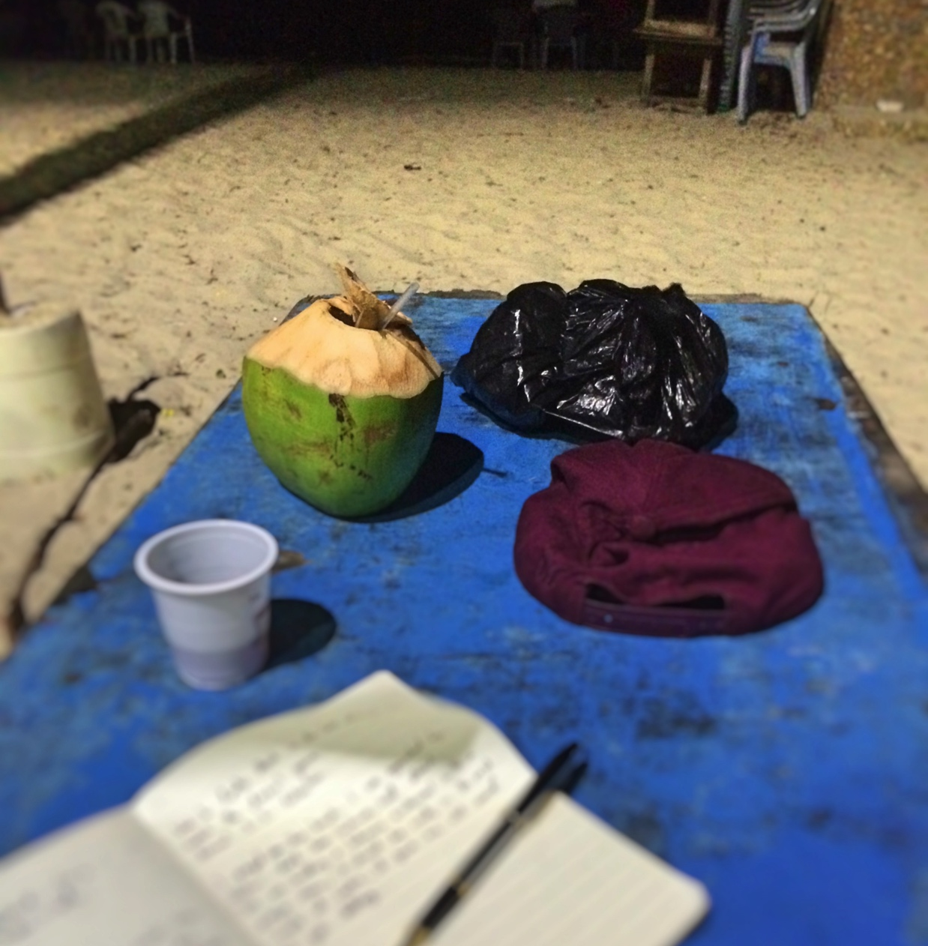
After work….

Slide 10
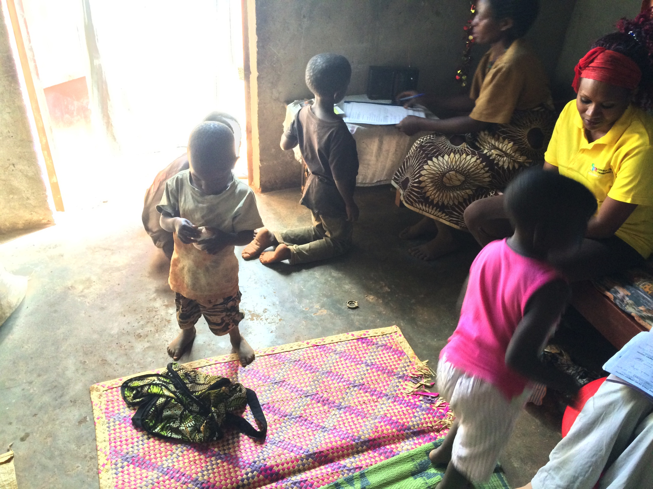
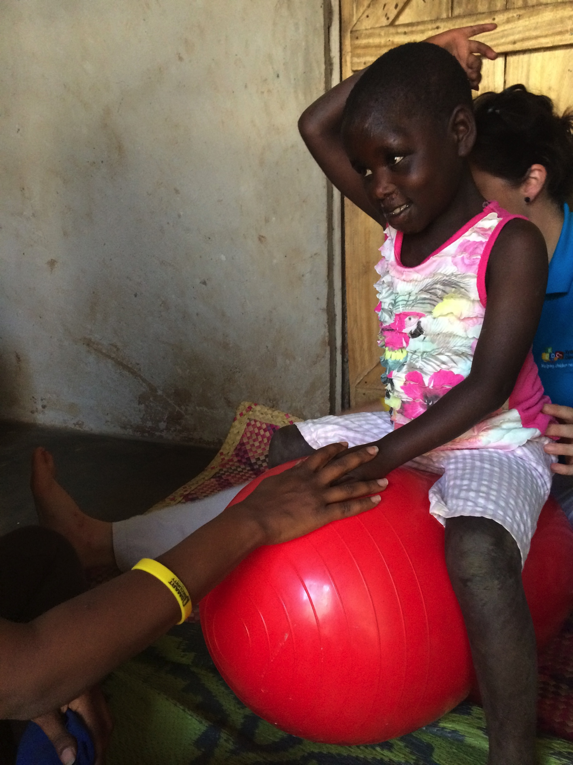
Other work based activities

Slide 11
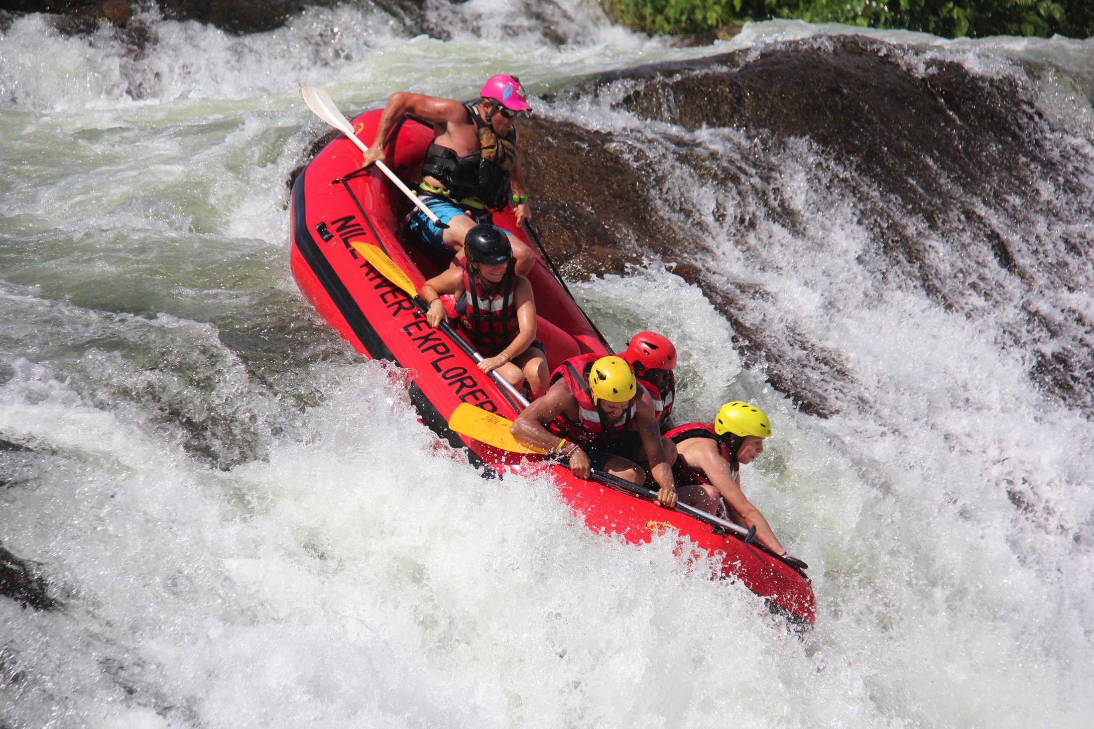
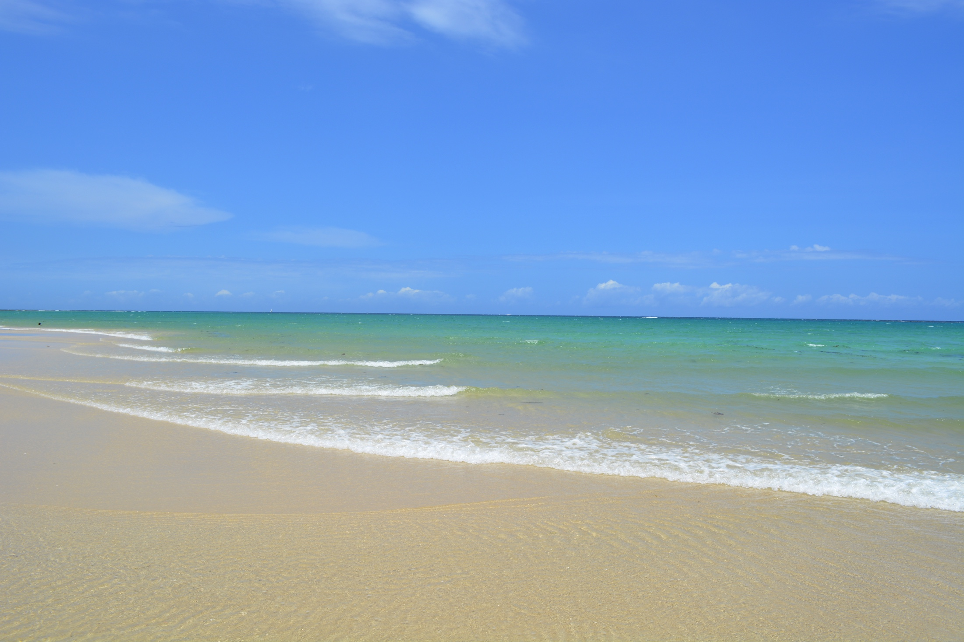
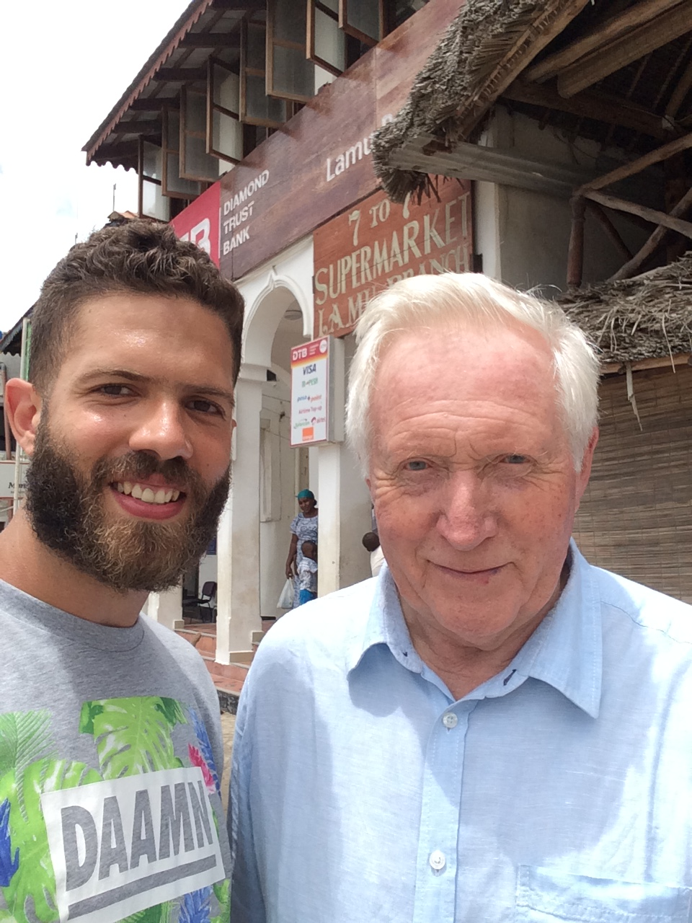
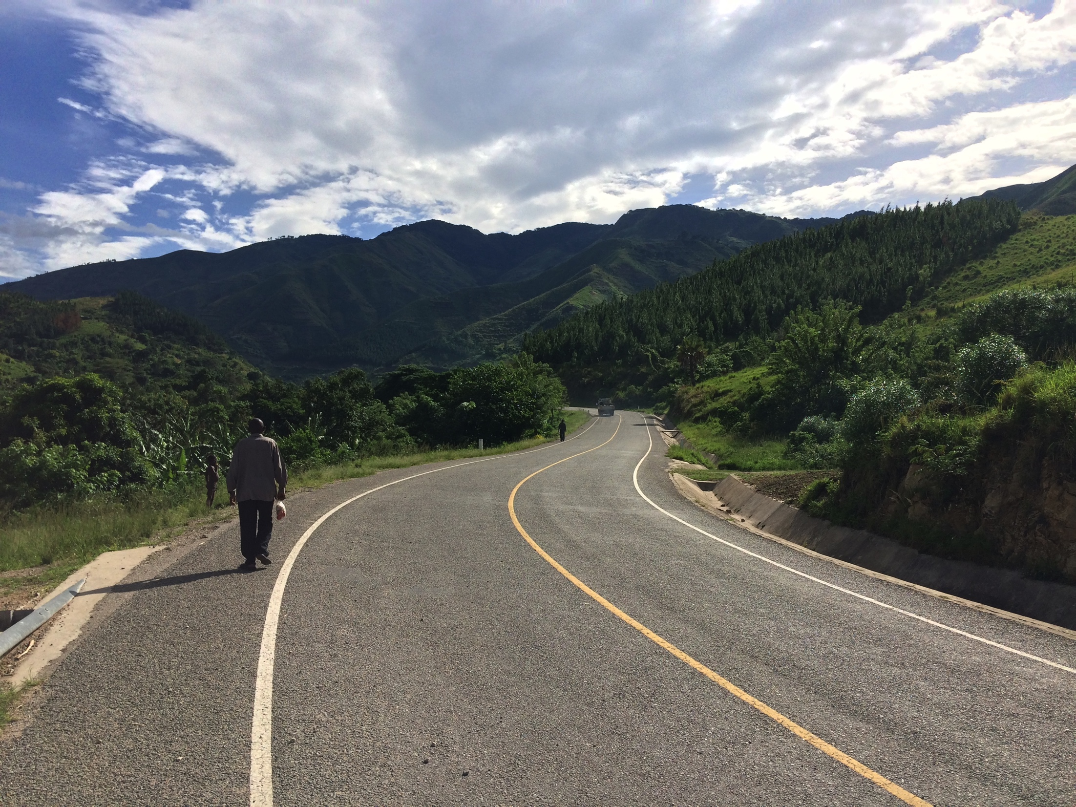
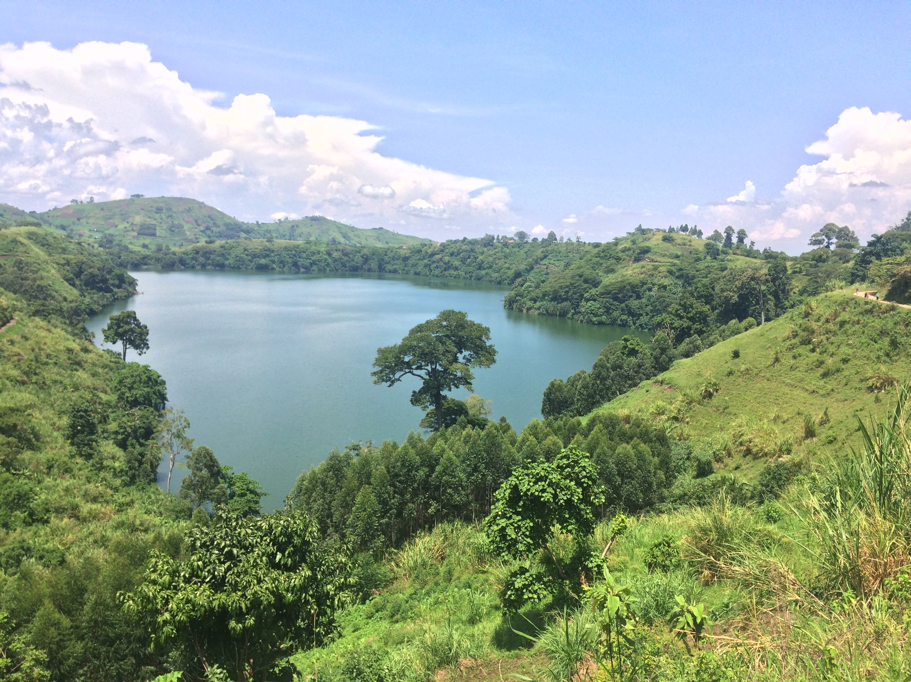
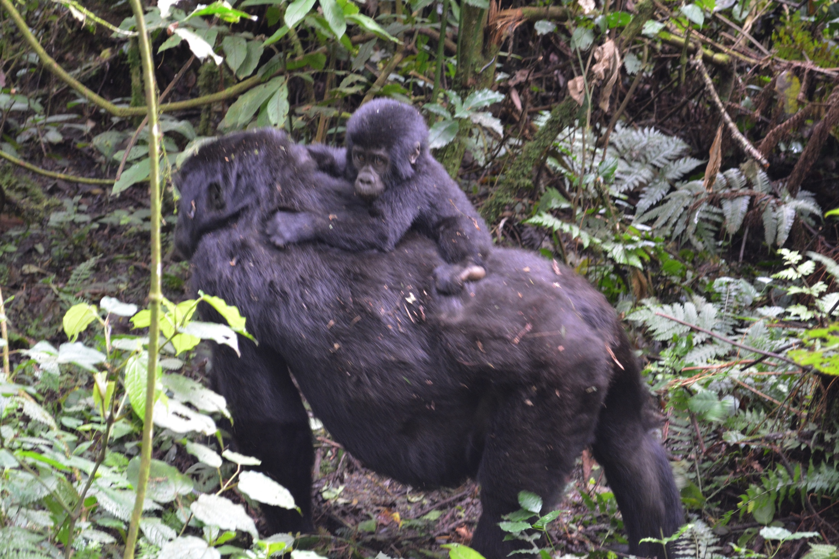
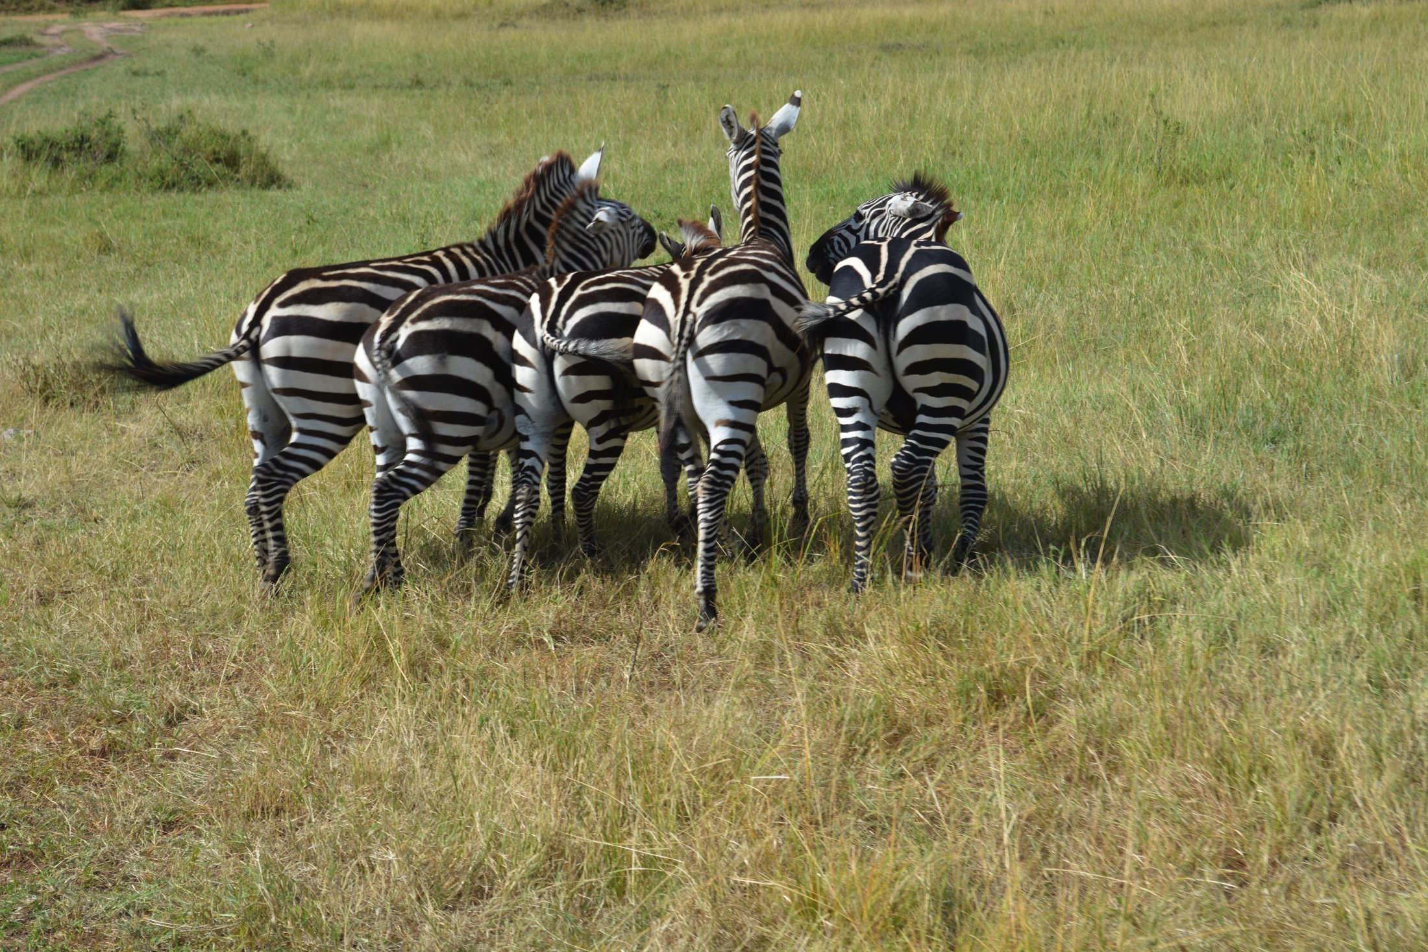
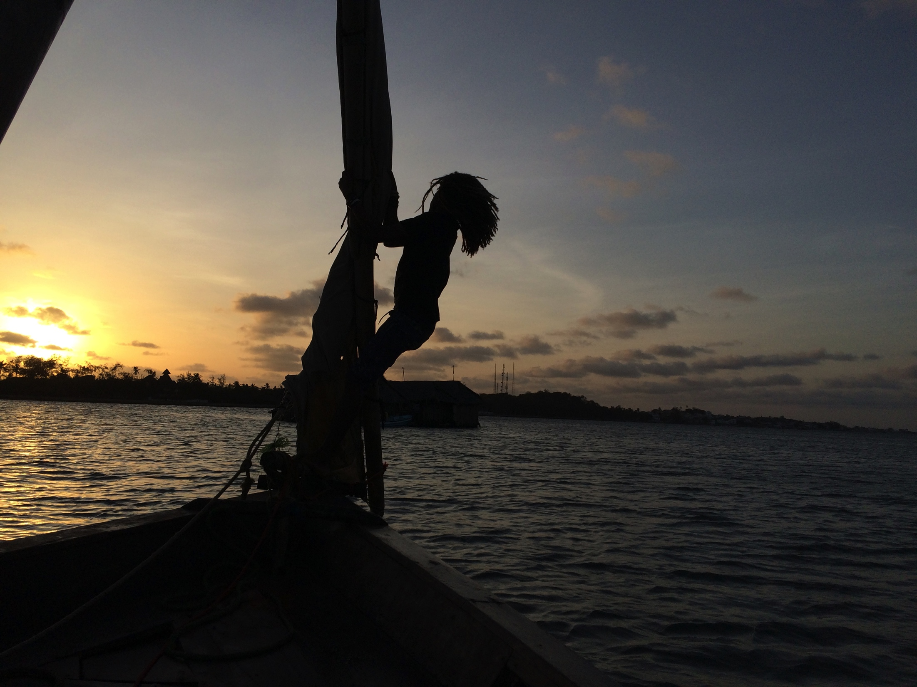
Weekends / Time off

Slide 12
Things to consider….
Intermittent internet
Periods of social media shut down – Tunnel Bear VPN
Power cuts – power bank
Pre-paid card – www.revolut.com
Try to learn a few words – locals love it!

Slide 13
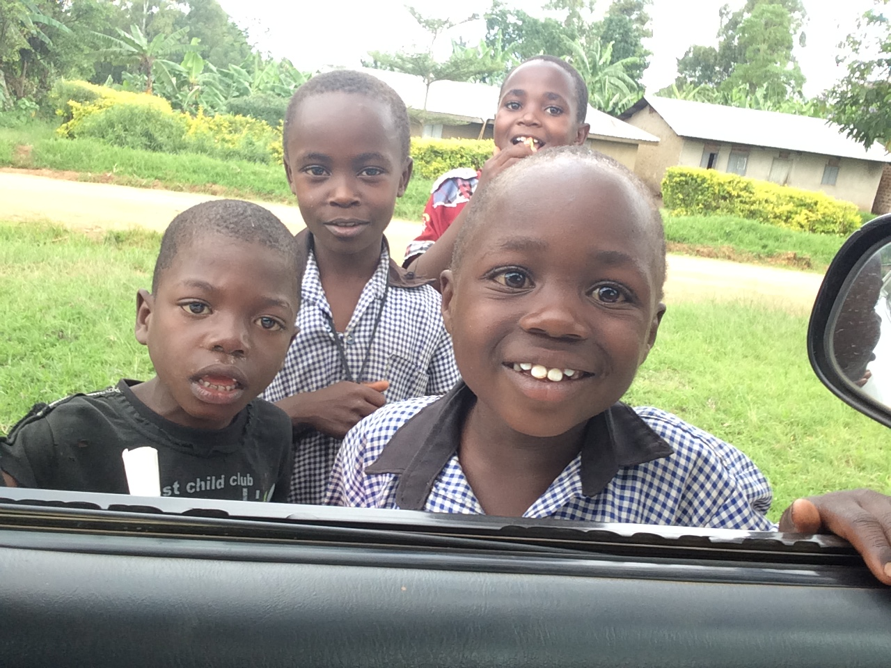
Don’t Hesitate…..... Go for it!

